Slide 1
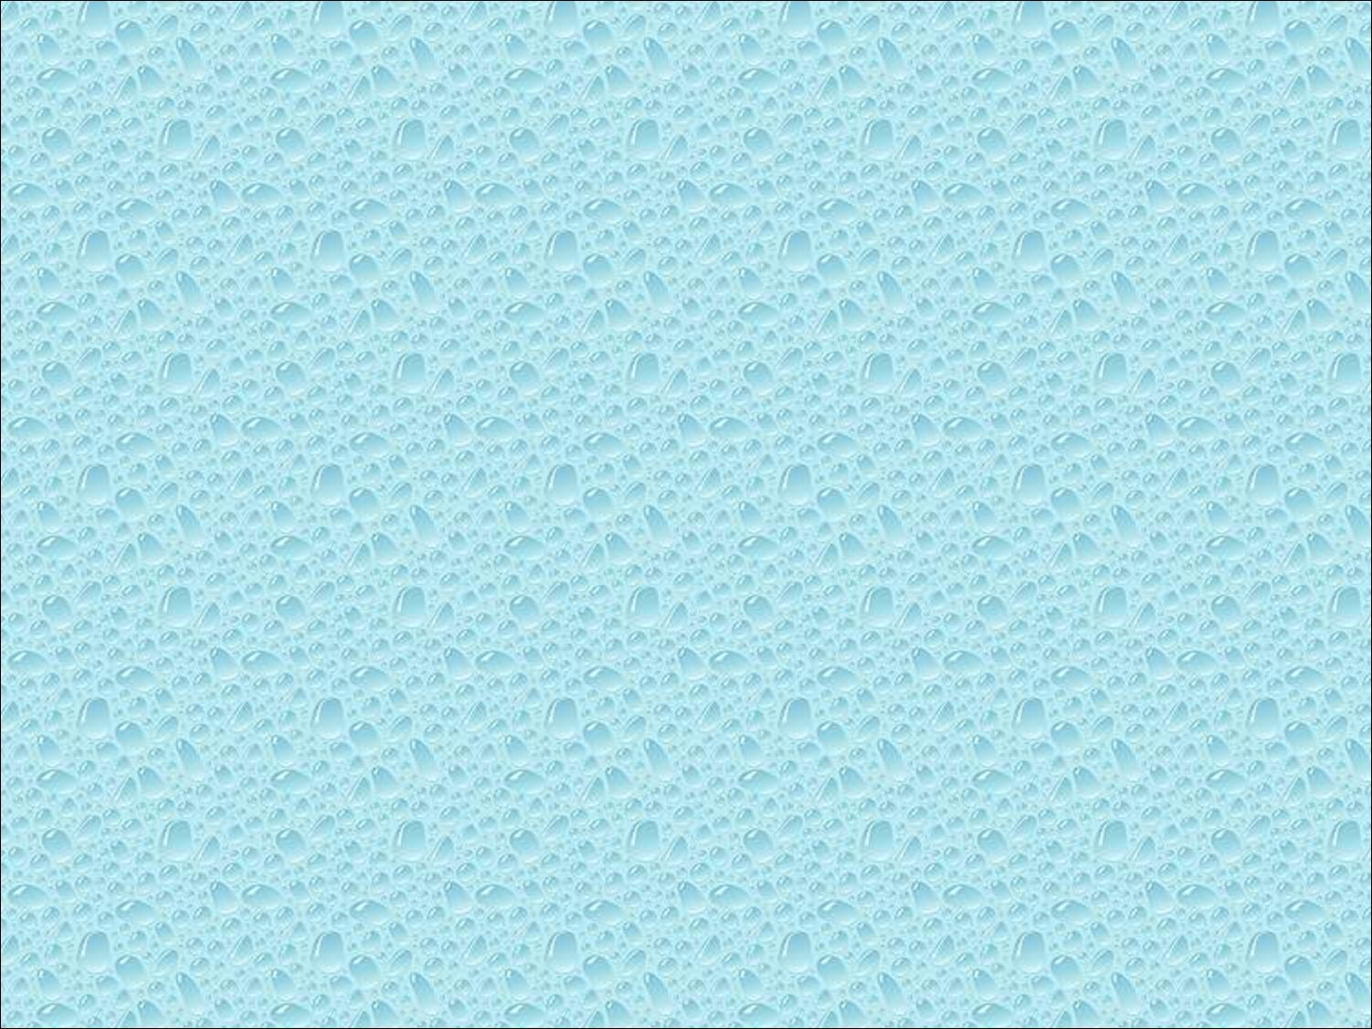


Slide 2

Introduce the elements of geometry
  Scalars
  Vectors
  Points
Develop mathematical operations among them in a coordinate-free manner
Define basic primitives
  Line segments
  Polygons

Slide 3
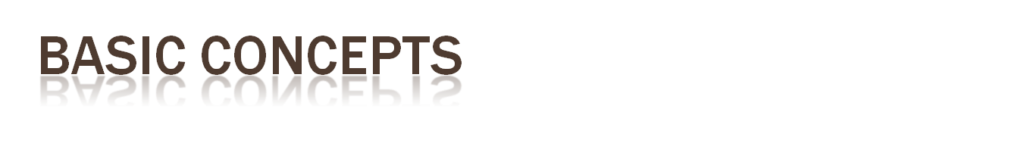
A vector space (向量空間)
    Scalars (係數)
    Vectors (向量)
    Two operation: vector to vector addition and scalar to vector multiplication
    (向量對向量加法和係數對向量乘法)
A base of n dimensional vector space
( n 維向量空間的一組基底)
{u1, u2, u3, ….un} is a base of Rn
If and only if α1 u1 + α2 u2 +…+ αn un =0 imply α1= α2 =….= αn =0

Slide 4

Is the set of vectors {[1, 1, 0], [2, 3, 0], [0, 1, 1], [1, 1, 1]} a basis of the 3-D Cartesian coordinate space?
空間中有三個點，分別為 (0, 0, 0), (1, 2, 3), (-4, 2, 1)，請求出通過這些點的平面方程式。

Slide 5
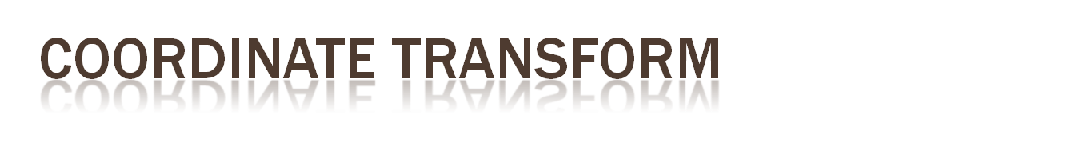
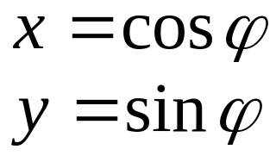
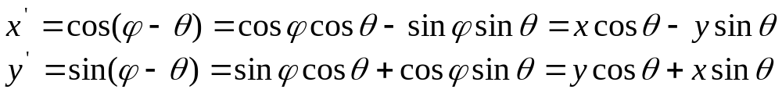
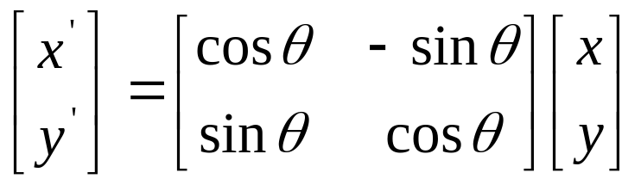
y
(x, y)
由圖可知
另外
所以新舊座標間為
y’
φ
x’
θ
x

Slide 6
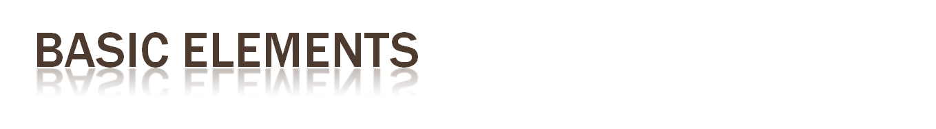
Geometry is the study of the relationships among objects in an n-dimensional space
  In computer graphics, we are interested in objects that exist in three dimensions
Want a minimum set of primitives from which we can build more sophisticated objects
We will need three basic elements
  Scalars
  Vectors
  Points

Slide 7
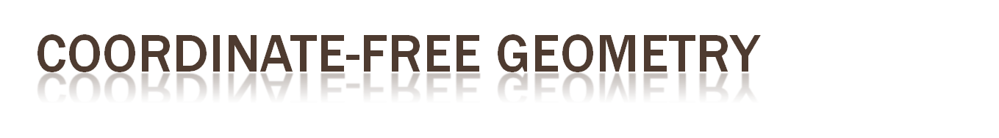
When we learned simple geometry, most of us started with a Cartesian approach
  Points were at locations in space p=(x,y,z)
  We derived results by algebraic manipulations involving these coordinates
This approach was nonphysical
  Physically, points exist regardless of the location of an arbitrary coordinate system
  Most geometric results are independent of the coordinate system
  Example Euclidean geometry: two triangles are identical if two corresponding sides and the angle between them are identical

Slide 8

Need three basic elements in geometry
  Scalars, Vectors, Points
Scalars can be defined as members of sets which can be combined by two operations (addition and multiplication) obeying some fundamental axioms (associativity, commutivity, inverses)
Examples include the real and complex number systems under the ordinary rules with which we are familiar
Scalars alone have no geometric properties

Slide 9
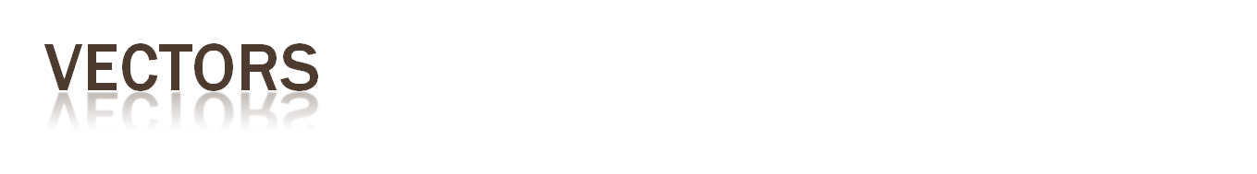
Physical definition: a vector is a quantity with two attributes
  Direction
  Magnitude
Examples include
  Force
  Velocity
  Directed line segments
    Most important example for graphics
    Can map to other types
v

Slide 10
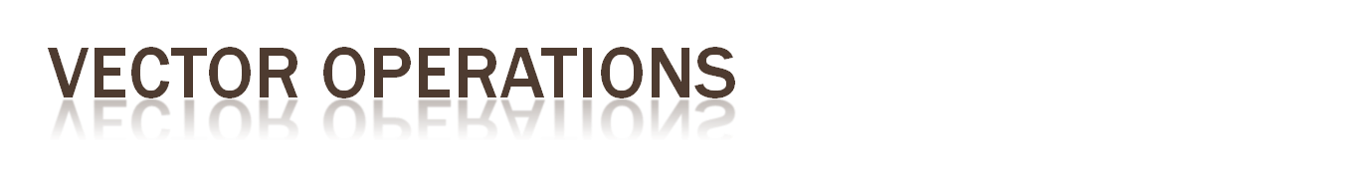
Every vector has an inverse
  Same magnitude but points in opposite direction
Every vector can be multiplied by a scalar
There is a zero vector
  Zero magnitude, undefined orientation
The sum of any two vectors is a vector
  Use head-to-tail axiom
v
w
v
-v
αv
u

Slide 11

Mathematical system for manipulating vectors
Operations
  Scalar-vector multiplication u=αv
  Vector-vector addition: w=u+v
Expressions such as
  v=u+2w-3r
Make sense in a vector space

Slide 12
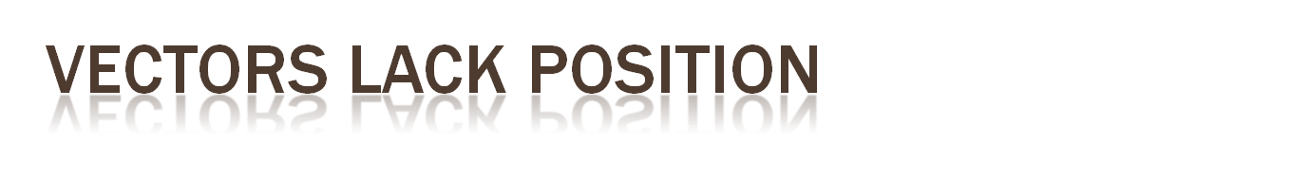
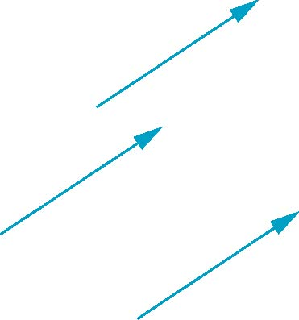
These vectors are identical
  Same length and magnitude
Vectors spaces insufficient for geometry
  Need points

Slide 13
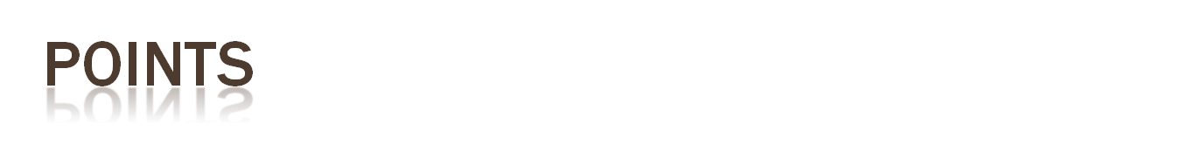
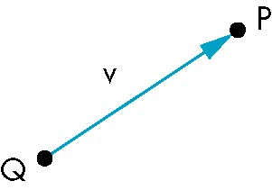
Location in space
Operations allowed between points and vectors
  Point-point subtraction yields a vector
  Equivalent to point-vector addition
v=P-Q
P=v+Q

Slide 14

Point + a vector space
Operations
  Vector-vector addition
  Scalar-vector multiplication
  Point-vector addition
  Scalar-scalar operations
For any point define
  1 • P = P
  0 • P = 0 (zero vector)

Slide 15

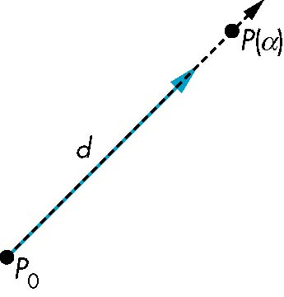
Consider all points of the form
  P(α)=P₀ + α d
  Set of all points that pass through P₀ in the direction of the vector d

Slide 16
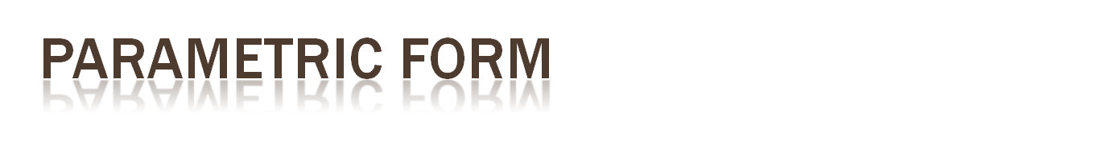
This form is known as the parametric form of the line
  More robust and general than other forms
  Extends to curves and surfaces
Two-dimensional forms
  Explicit: y = mx +h
  Implicit: ax + by +c =0
  Parametric:
  x(α) = αx₀ + (1-α)x₁
  y(α) = αy₀ + (1-α)y₁

Slide 17

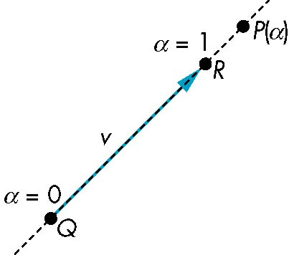
If α >= 0, then P(α) is the ray leaving P₀ in the direction d
If we use two points to define v, then
P( α) = Q + α (R-Q)=Q+αv
=αR + (1-α)Q
For 0<=α<=1 we get all the
points on the line segment
joining R and Q

Slide 18

An object is convex iff for any two points in the object all points on the line segment between these points are also in the object
P
P
Q
Q
not convex
convex

Slide 19

Consider the “sum”
P=α₁P₁+α₂P₂+…..+α_{n}P_{n}
Can show by induction that this sum makes sense iff
α₁+α₂+…..α_{n}=1
in which case we have the affine sum of the points P₁,P₂,…..P_{n}
If, in addition, α_{i}>=0, we have the convex hull of P₁,P₂,…..P_{n}

Slide 20

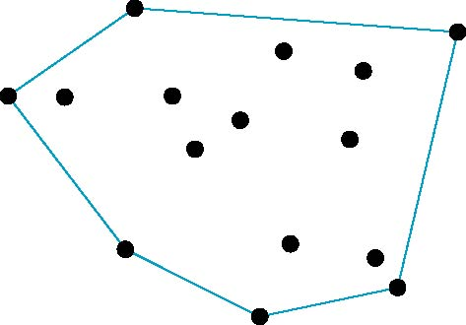
Smallest convex object containing P₁,P₂,…..P_{n}
Formed by “shrink wrapping” points

Slide 21

Curves are one parameter entities of the form P(α) where the function is nonlinear
Surfaces are formed from two-parameter functions P(α, β)
  Linear functions give planes and polygons
P(α)
P(α, β)

Slide 22

A plane can be defined by a point and two vectors or by three points
P
v
Q
R
u
R
P(α,β)=R+αu+βv
P(α,β)=R+α(Q-R)+β(P-Q)

Slide 23
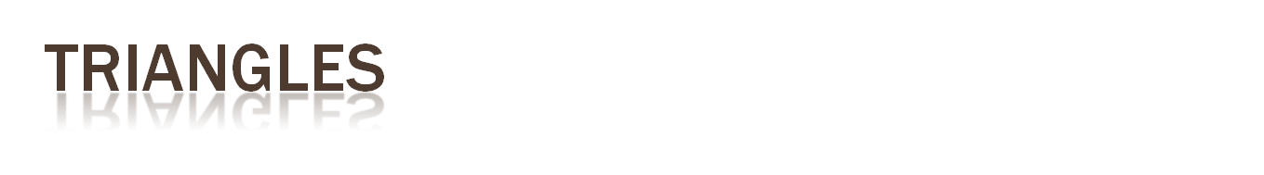
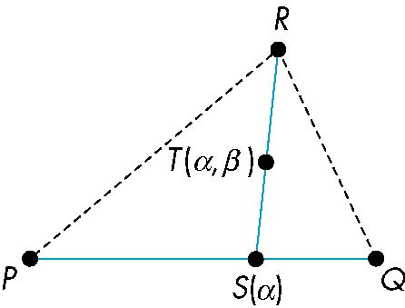
convex sum of P and Q
convex sum of S(α) and R
for 0<=α,β<=1, we get all points in triangle

Slide 24
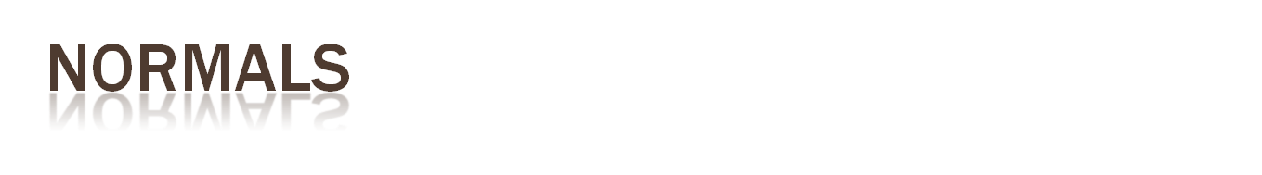
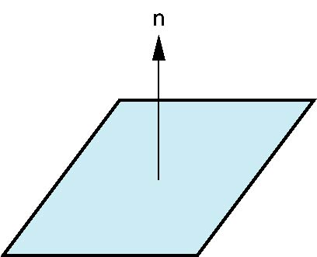
Every plane has a vector n normal (perpendicular, orthogonal) to it
From point-two vector form P(α,β)=R+αu+βv, we know we can use the cross product to find n = u × v and the equivalent form
(P(α)-P) ⋅ n=0
v
u
P

